Slide 1

Greenhouse Environment Monitoring and Control using Edge Computing
SRM INSTITUTE OF SCIENCE AND TECHNOLOGY
SCHOOL OF COMPUTING
DEPARTMENT OF COMPUTING TECHNOLOGIES
MAJOR PROJECT / INTERNSHIP
Guide name: Dr. M. Suganiya
Designation: Assistant Professor Department: Computing Technologies
Batch ID: 1
Student 1 Reg. No: RA2111003010136
Student 1 Name: Aman Pandey
Student 2 Reg. No: RA2111003010129
Student 2 Name: Ritam Biswas

Slide 2
Abstract
This project develops a smart greenhouse monitoring system using an ESP microcontroller to track environmental parameters such as temperature, humidity, soil moisture, and light intensity. A digital twin enables real-time visualization, while machine learning algorithms predict trends and automate actuators to maintain ideal growing conditions. By optimizing resource use and improving crop yields, this system offers an efficient and scalable solution for modern precision agriculture.

Slide 3
Introduction
Greenhouse farming provides a controlled environment for optimized crop growth but requires constant monitoring and adjustments to maintain ideal conditions. This project introduces a smart greenhouse monitoring system that integrates IoT, digital twin technology, and machine learning to streamline these processes. Using an ESP microcontroller, the system tracks environmental parameters such as temperature, humidity, soil moisture, and light intensity. A digital twin offers real-time visualization of conditions, while machine learning predicts trends and automates actuators like fans and irrigation systems to maintain optimal settings. This approach reduces manual intervention, improves resource efficiency, and enhances crop yields, showcasing the potential of IoT and AI to transform modern agriculture.

Slide 4
Literature Review
Author | Title | Method | Remarks
Fillali Zahra et al | Machine learning algorithms to assess the thermal behavior of a Moroccan agriculture greenhouse | Used ANN and MLR to model greenhouse thermal behavior using climate data. | Highlights ML’s role in optimizing greenhouse climate control.
Y. Jeevan Nagendra Kuma et al. | Predictive Modeling for Enhanced Plant Cultivation in Greenhouse Environment | Developed predictive models using climate and soil data to improve plant growth. | Focuses on data-driven approaches for better crop yield and resource efficiency.
Yukimasa Kaneda et al. | Greenhouse Environmental Control System Based on SW-SVR | Implemented Sliding Window Support Vector Regression (SW-SVR) for climate control. | Enhances greenhouse management by precise environmental adjustments.

Slide 5
Literature Review
Author | Title | Method | Remarks
Vikram Singh | Advances in Precision Agriculture Technologies for Sustainable Crop Production | Reviewed precision agriculture technologies for sustainable crop management. | Focuses on integrating technology to enhance crop productivity and sustainability.
Romain Gautron et al. | Reinforcement Learning for Crop Management Support: Review, Prospects and Challenges | Reviewed RL techniques for crop management and discussed challenges and future prospects. | Highlights the potential of RL in optimizing agricultural decision-making.
Renny Eka Putri et al. | Monitoring and Controlling System of Smart Mini Greenhouse Based on Internet of Things (IoT) for Spinach Plant | Developed an IoT-based system for monitoring and controlling a mini greenhouse for spinach cultivation. | Focuses on real-time monitoring and automation for improved plant care.

Slide 6
Literature Review
Author | Title | Method | Remarks
Natasja Ariesen-Verschuur et al. | Digital Twins in Greenhouse Horticulture: A Review | Reviewed the application of digital twins in greenhouse management for improved efficiency. | Explores the potential of digital twins to optimize horticultural processes and decision-making.
Ravi Kishore Kodali, Vishal Jain, Sumit Karagwal | IoT-Based Smart Greenhouse System | Utilizes microcontrollers, foggers for cooling, RFID for tracking produce | Enhances farming by direct farmer-to-consumer connection and automated systems
Sriram Tammineedu, Yaramati Naga Venkata Nikhil | IoT Based Greenhouse Controlling and Monitoring System | Designed an IoT system for real-time monitoring and automated control of greenhouse conditions. | Aims to optimize greenhouse management through integrated IoT solutions for climate control.

Slide 7
Problem statement
Traditional greenhouse systems often rely on manual monitoring and control of environmental parameters, which can be inefficient, time-consuming, and prone to human error. Furthermore, reactive systems fail to anticipate changes in conditions, leading to suboptimal resource use and potential harm to crops. There is a need for an automated solution that not only monitors conditions in real-time but also utilizes predictive models to anticipate changes and take proactive measures. This would enable precise control of actuators and ensure optimal growing conditions, enhancing resource efficiency and crop productivity while reducing manual intervention.

Slide 8
Objectives
Automated Monitoring and Control: Develop an automated greenhouse monitoring system using ESP microcontrollers for real-time data collection and control of environmental parameters.
Digital Twin Integration: Implement a digital twin to enable live visualization and remote monitoring of greenhouse conditions.
Resource Optimization: Enhance resource efficiency and crop productivity by maintaining ideal growing conditions through automation.
Predictive Modeling: Utilize machine learning-based predictive models to forecast environmental changes and enable proactive control of actuators.

Slide 9
Proposed Systems
The proposed system integrates IoT, digital twin technology, and predictive analytics to automate greenhouse management. An ESP microcontroller will monitor key environmental parameters such as temperature, humidity, soil moisture, and light intensity, transmitting data wirelessly for analysis and control. A digital twin will provide a virtual representation of the greenhouse, enabling live visualization and remote monitoring. Machine learning algorithms will analyze data to predict environmental changes and automatically activate actuators like fans, irrigation systems, and heaters to maintain ideal conditions. This system minimizes manual intervention, optimizes resource use, and ensures sustainable crop growth.

Slide 10
Proposed Systems
Key Features
IoT-Enabled Monitoring: Real-time tracking of temperature, humidity, soil moisture, and light intensity using ESP microcontrollers and connected sensors.
Digital Twin Technology: A virtual replica of the greenhouse for live visualization and remote monitoring of environmental conditions.
Predictive Analytics: Machine learning algorithms to forecast environmental changes and proactively adjust settings.

Slide 11
Proposed Systems
Key Features
Automated Control: Actuation of systems such as fans, heaters, irrigation, and lighting based on predictive models to maintain ideal conditions.
Resource Optimization: Enhanced efficiency in water, energy, and nutrient use, reducing waste and improving sustainability.
Scalability and Flexibility: Easily adaptable for different greenhouse sizes and configurations.

Slide 12
Proposed Systems
Modules Used
ESP Micro-controller: Handles sensor data collection, processing, and wireless communication for live monitoring.
Temperature and Humidity Sensor (DHT11): Measures the temperature and humidity levels inside the greenhouse to ensure optimal growing conditions.
Soil Moisture Sensor: Monitors soil moisture levels and triggers irrigation systems when moisture falls below a predefined threshold.

Slide 13
Proposed Systems
Modules Used
Light Intensity Sensor: Measures light intensity to assess the adequacy of light for plant growth and adjust artificial lighting as needed.
Mini DC Fans: Controls ventilation to regulate temperature and humidity.
Water Pump: Automates irrigation based on soil moisture levels.
LED Grow Lights: Provides additional light when natural light is insufficient.
Power Supply: Provides necessary energy for sensors, actuators, and the ESP device to function.

Slide 14
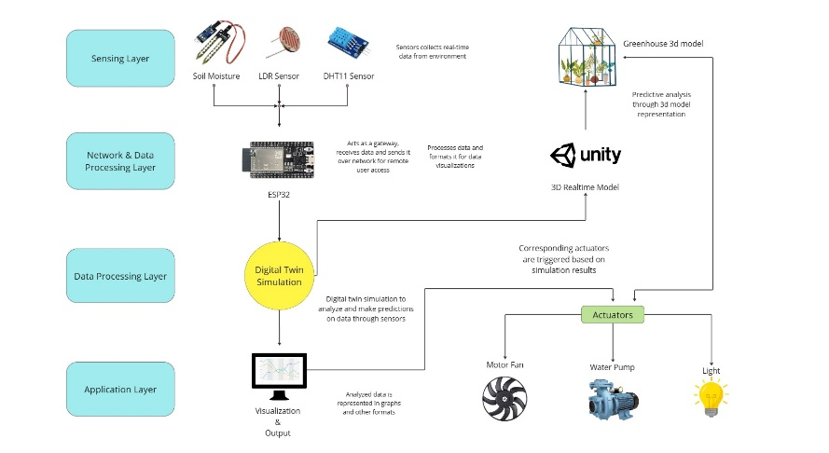
Proposed Systems

Slide 15
Proposed Systems
Planning and Research
Design and Setup
Development and Integration
Testing and Calibration
Deployment

Slide 16
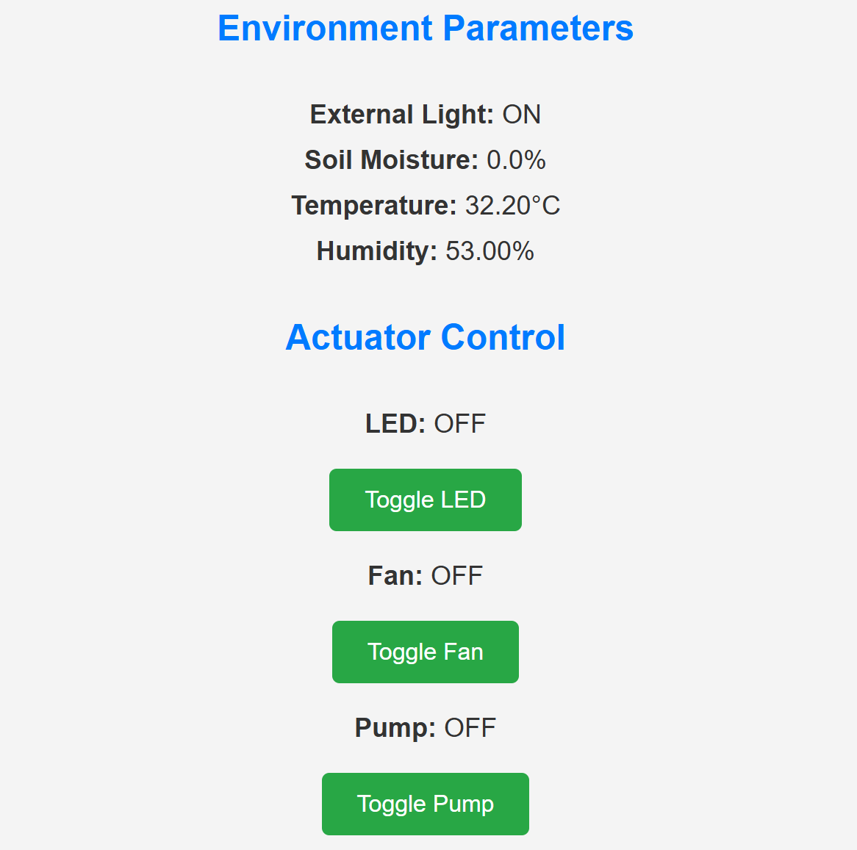
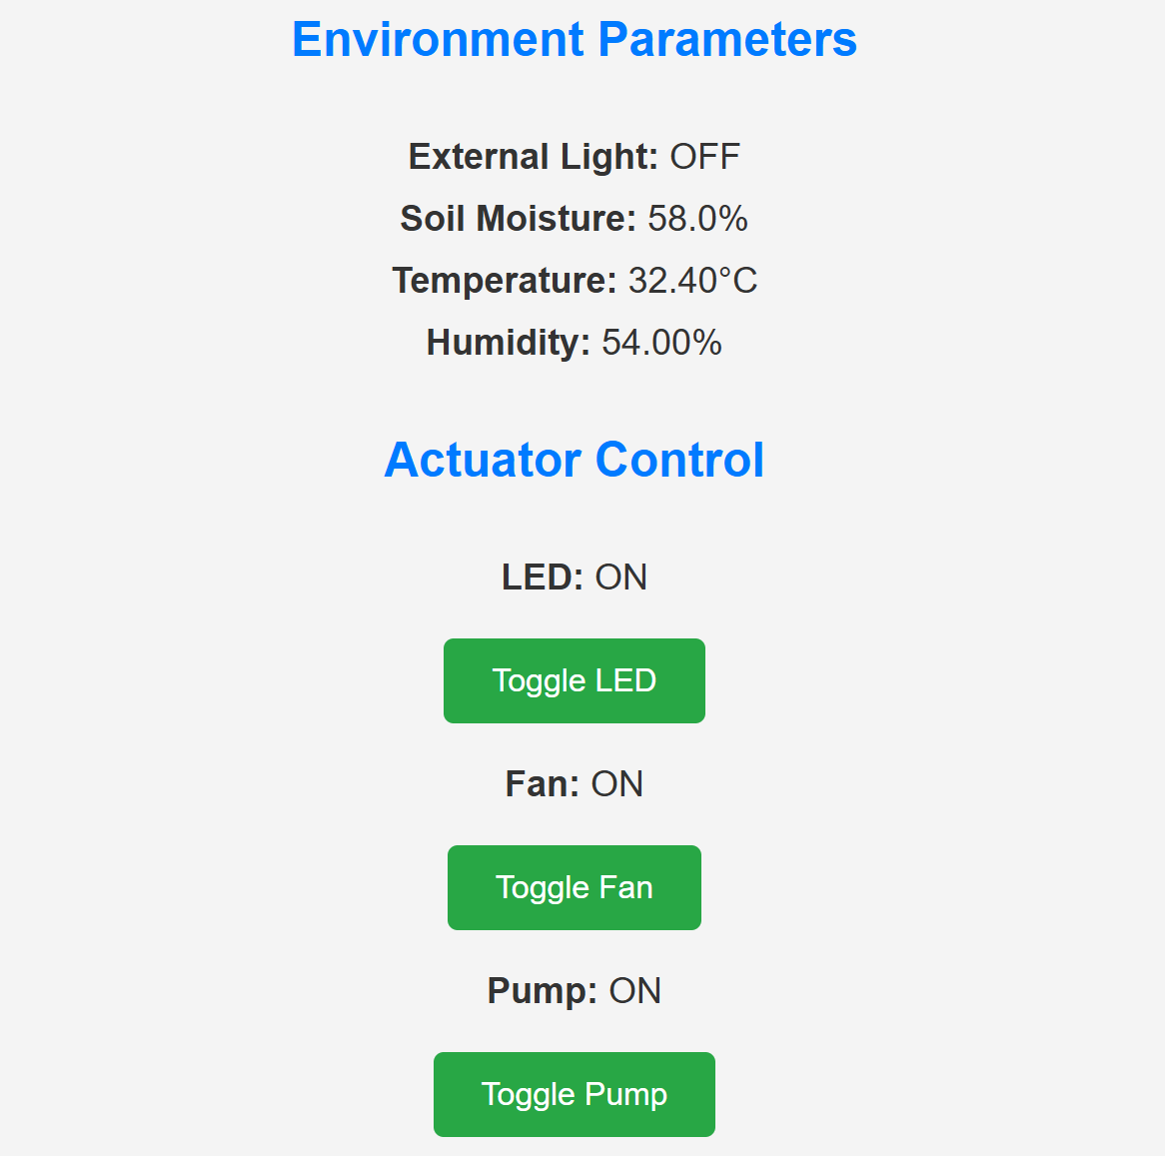
Results
Web Server Output

Slide 17
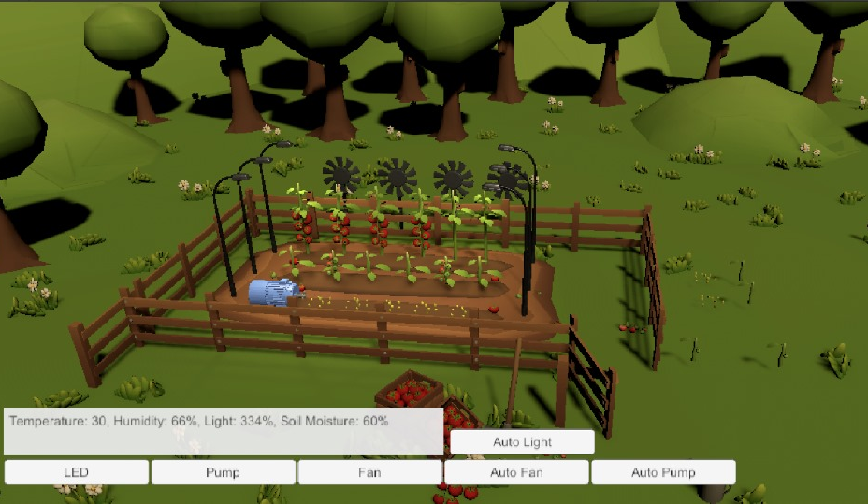
Results
Digital Twin Simulation

Slide 18
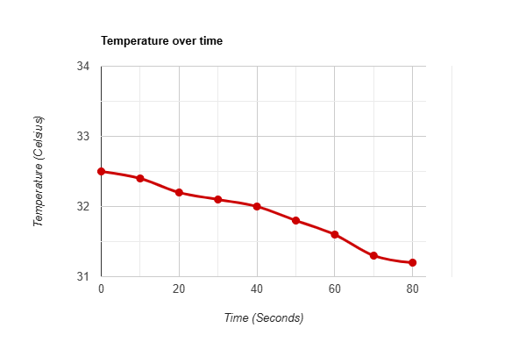
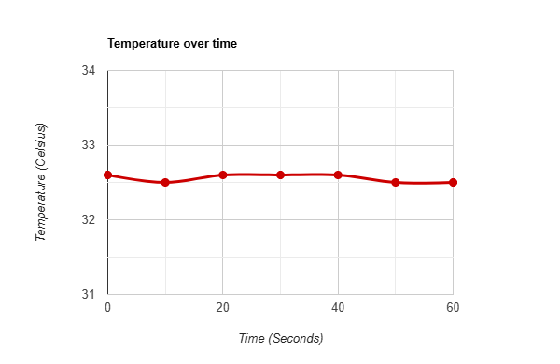
Results
Parameter Readings
Regular Temperature Readings
Readings after fan

Slide 19
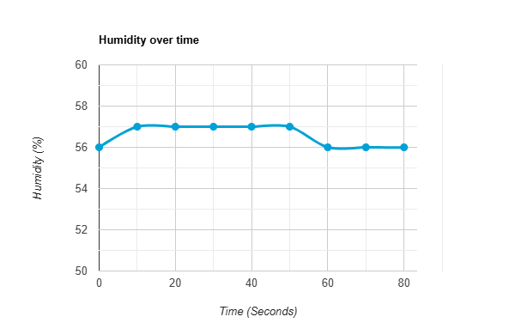
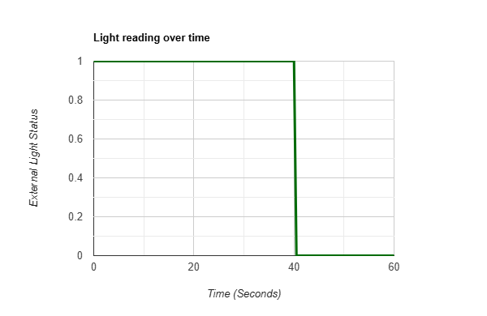
Results
Parameter Readings
Regular Humidity Readings
Light readings after obstruction

Slide 20
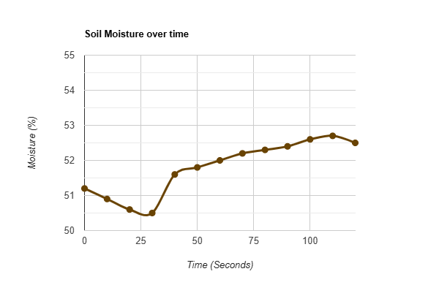
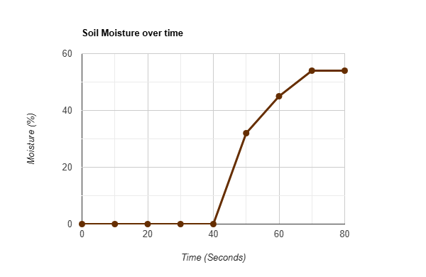
Results
Parameter Readings
Soil Moisture Readings
Moisture Increase Spike

Slide 21
References
Fillali, Z., Mohammed, E., Abderrahmane, K., & Salahddine, C. (2021). Machine learning algorithms to assess the thermal behavior of a Moroccan agriculture greenhouse. Procedia Computer Science, 181, 416-423.
Kuma, Y. J. N., Chandan, R., Somanini, S. H., Vadtya, S., Pranay, Y. R. L., Mohammed, K. A., Chandrashekar, R., Kansal, L., & Kalra, R. (2022). Predictive modeling for enhanced plant cultivation in greenhouse environment. Frontiers in Sustainable Food Systems, 6, 1-9.
Kaneda, Y., Ibayashi, H., Oishi, N., & Mineno, H. (2020). Greenhouse environmental control system based on SW-SVR. Journal of Information Processing, 28, 477-484.
Singh, V. (2020). Advances in precision agriculture technologies for sustainable crop production. Agricultural Reviews, 41(1), 36-42.

Slide 22
References
Gautron, R., Maillard, O., Preux, P., Corbeels, M., & Sabbadin, R. (2022). Reinforcement learning for crop management support: Review, prospects, and challenges. Computers and Electronics in Agriculture, 198, 1-15.
Putri, R. E., Lestari, N. U., Ifmalinda, Arlius, F., Putri, I., & Hasan, A. (2020). Monitoring and controlling system of smart mini greenhouse based on IoT for spinach plant (Amaranthus sp.). Journal of Physics: Conference Series, 1524(1), 1-9.
Ariesen-Verschuur, N., Verdouw, C., Tekinerdogan, B. (2021). Digital twins in greenhouse horticulture: A review. Computers and Electronics in Agriculture, 187, 106295.
Kodali, R. K., Vimal Jain, & Karagwal, S. (2016). IOT-based smart greenhouse. 2016 IEEE Region 10 Humanitarian Technology Conference (R10-HTC).
Tammineedu, S., & Nikhil, Y. N. V. (2023). IoT-based greenhouse controlling and monitoring system. Undergraduate Project Report, Department of Electronics and Communication Engineering.

